Slide 1




TUT Labs
Management System Proposal
A Smart Solution for Real-Time Lab Monitoring and Scheduling
By: Tadiwanashe Songore

Slide 2

Overview
Problem Statement
Proposed Solution
Key Features
Future Implementations
Benefits to FoICT
Proposal & Request
Screenshots
Live Demonstration
Ending
01
02
03
04
05
06
07-09
10
11

Slide 3


Problem Statement
•• Manual lab management leads to inefficiencies.
•• Tutors have no central way to manage shifts.
•• Admins lack visibility and communication tools.
•• No historical record of lab openings or closures.

Slide 4
Proposed Solution
•• A cross-platform mobile and web app.
•• Real-time lab status updates (open/closed).
•• Admin dashboard to assign tutors and manage schedules.
•• Students can view lab status without logging in.

Slide 5


•• Role-based access (Admin, Tutor, Student).
Key Features
•• Firebase integration for real-time updates.
•• Schedule management with visibility.
•• Lab announcements and notes.

Slide 6


Future Implementations
01
02
03
04
•• PDF download of lab status per day.
•• Weekly reports of lab usage activity.
•• Notifications and email summaries.
•• Machine learning predictions on usage trends.

Slide 7


Benefits to TUT FoICT
01
02
03
04
•• Better resource allocation and lab tracking.
•• Improved tutor accountability.
•• Enhanced communication with students.
•• Digital transformation aligned with TUT goals.

Slide 8
•• Officially support the adoption of this system.
Proposal & Request
•• Grant access to relevant data and testing labs.
•• Collaborate to tailor the app to TUT's unique needs.
•• Consideration for a permanent software development position within the faculty
🙂

Slide 9

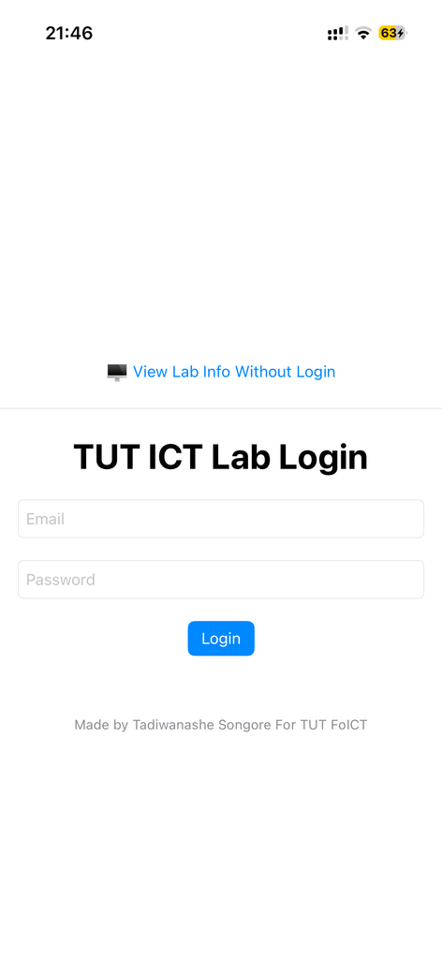
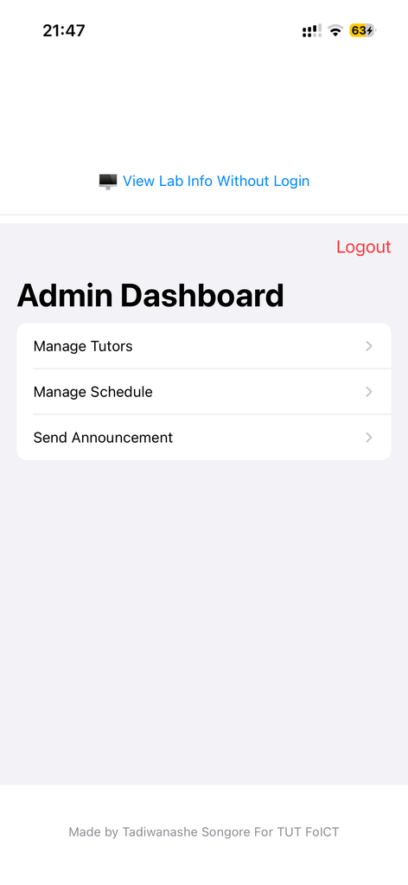
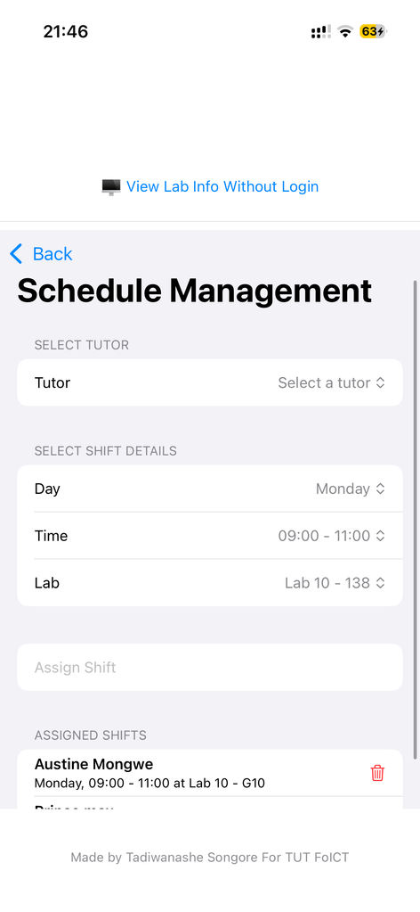
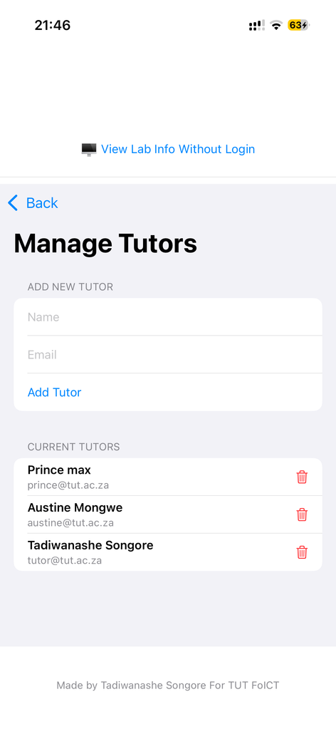
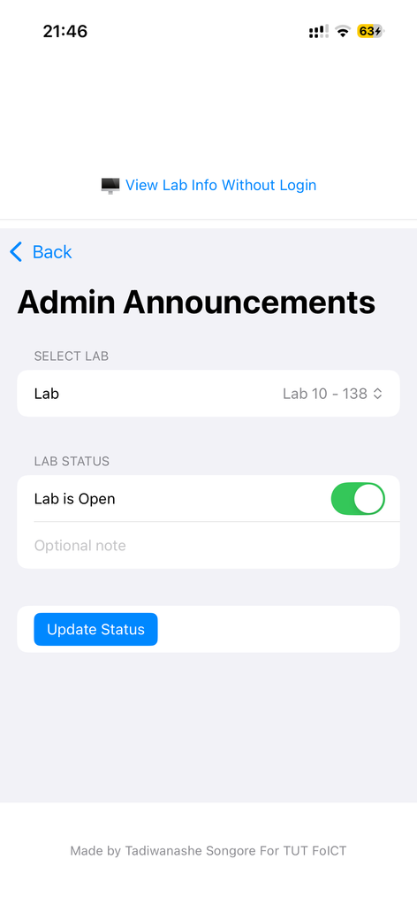
Screenshots Admin

Slide 10

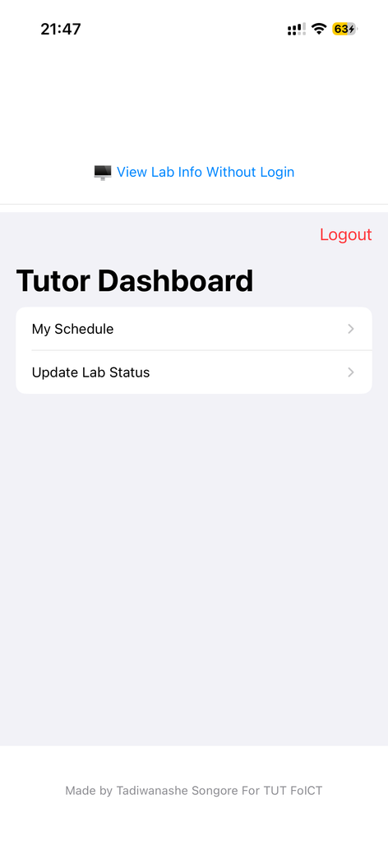
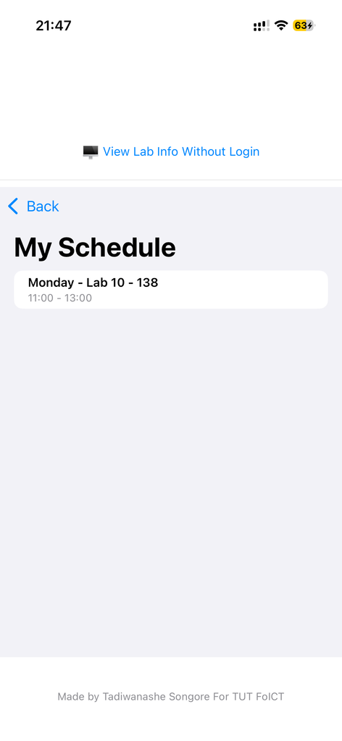
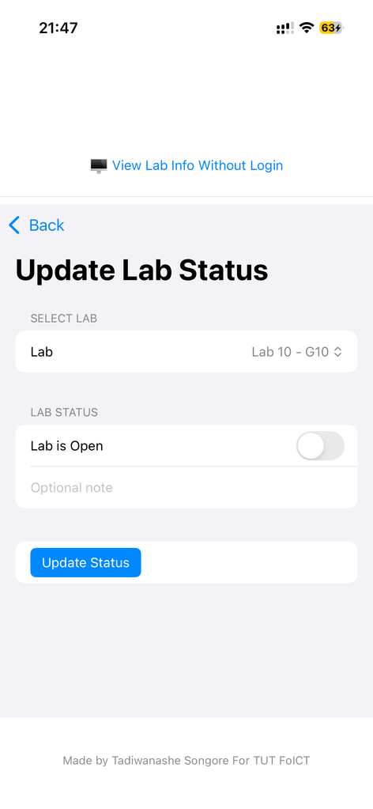
Screenshots Tutor

Slide 11

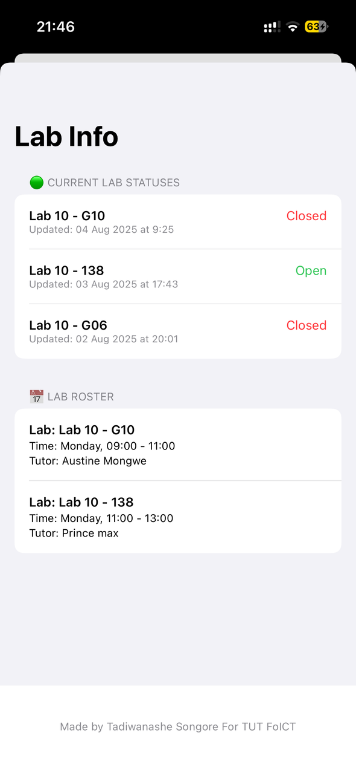
Screenshots Student

Slide 12
Live Demonstration

Slide 13




THANK TOU
For watching this presentation
Tadiwanashe Songore
+27 62 962 2755
Songore.tb@tut.ac.za
TUT South Campus

